Slide 2

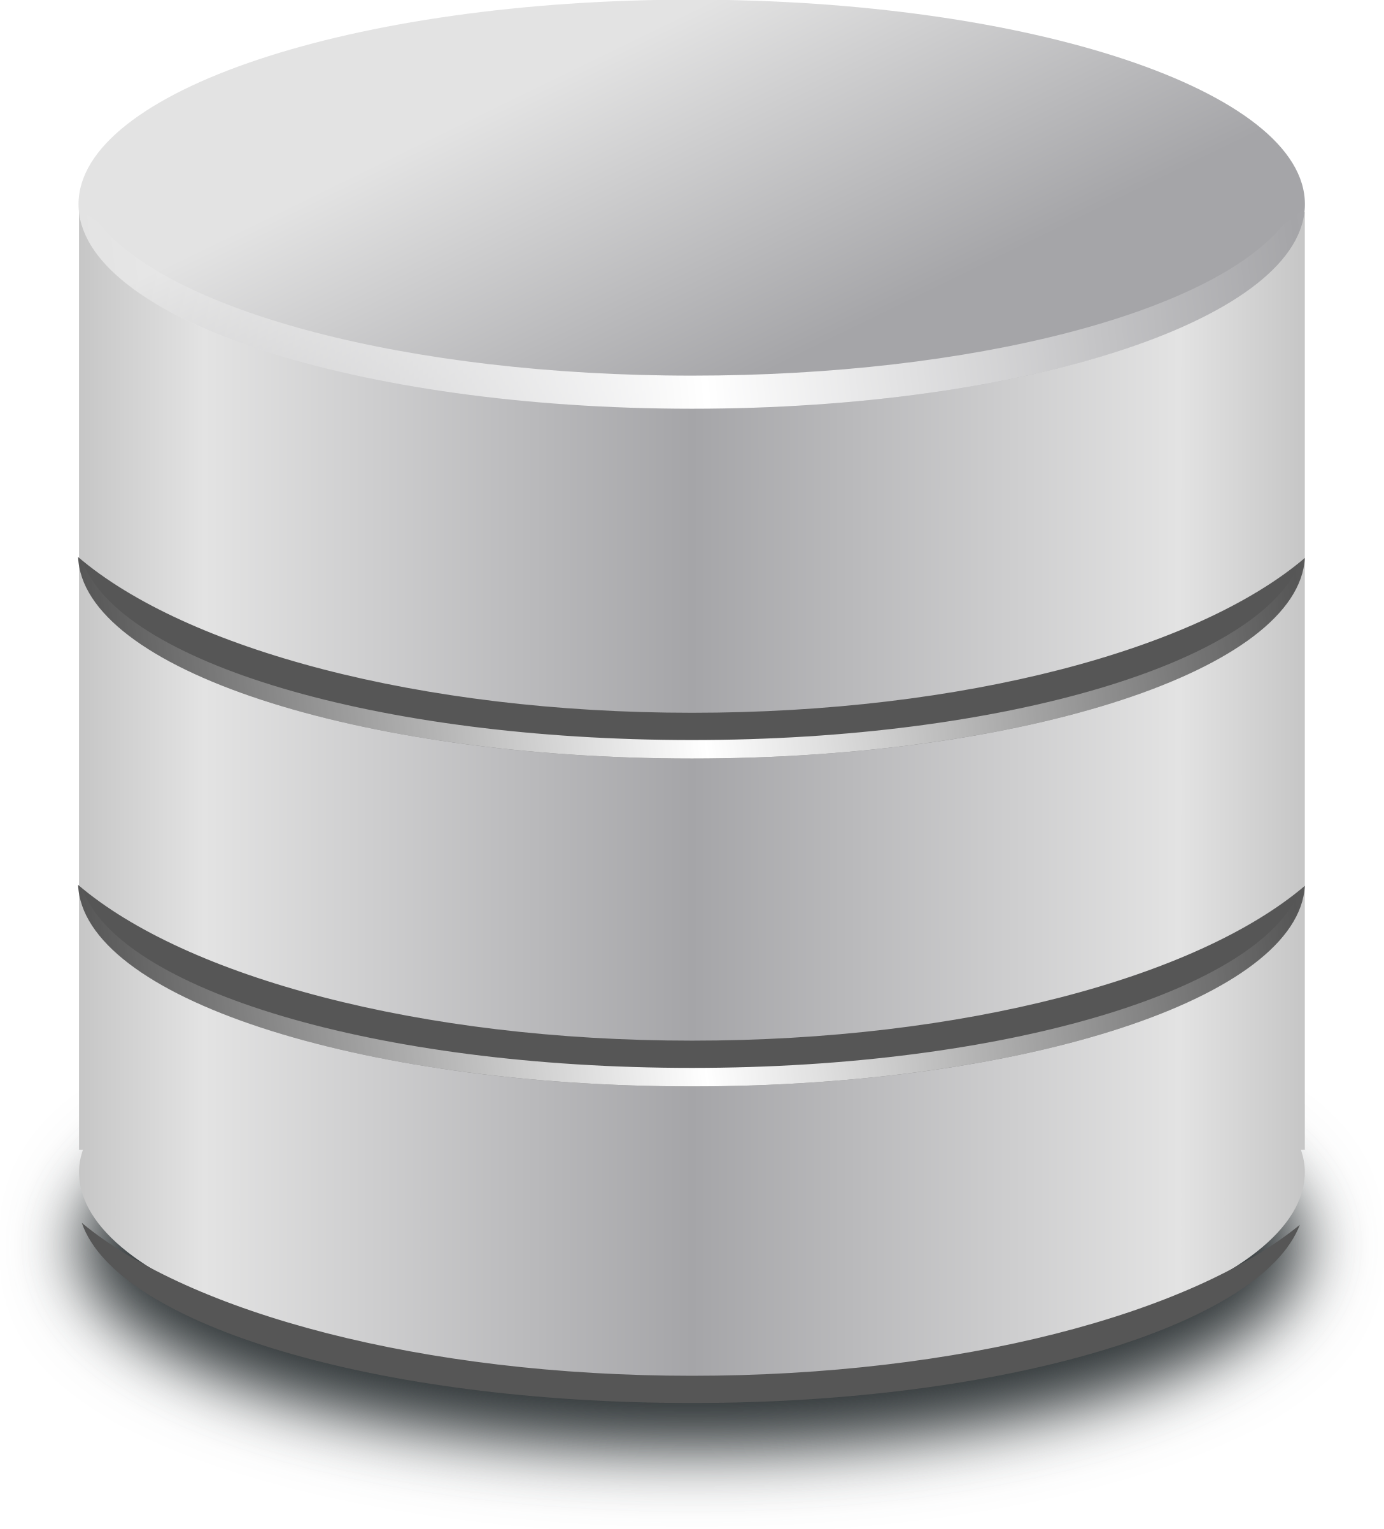

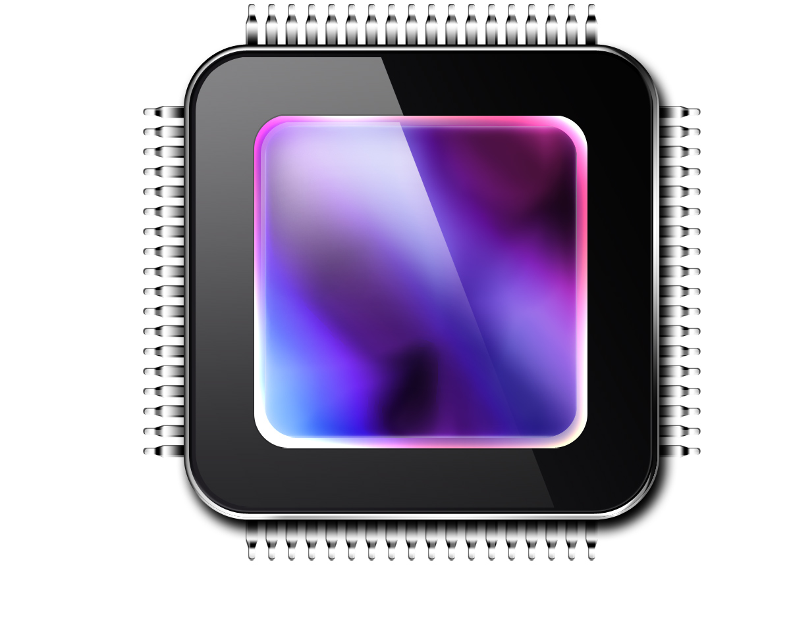
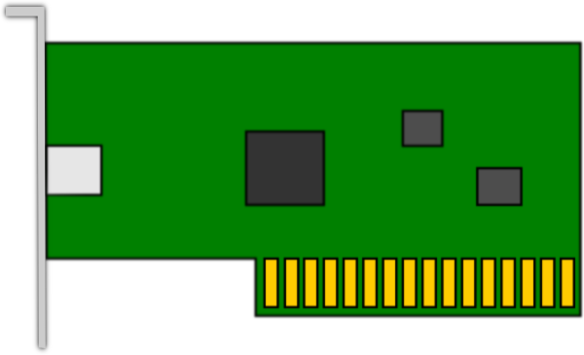
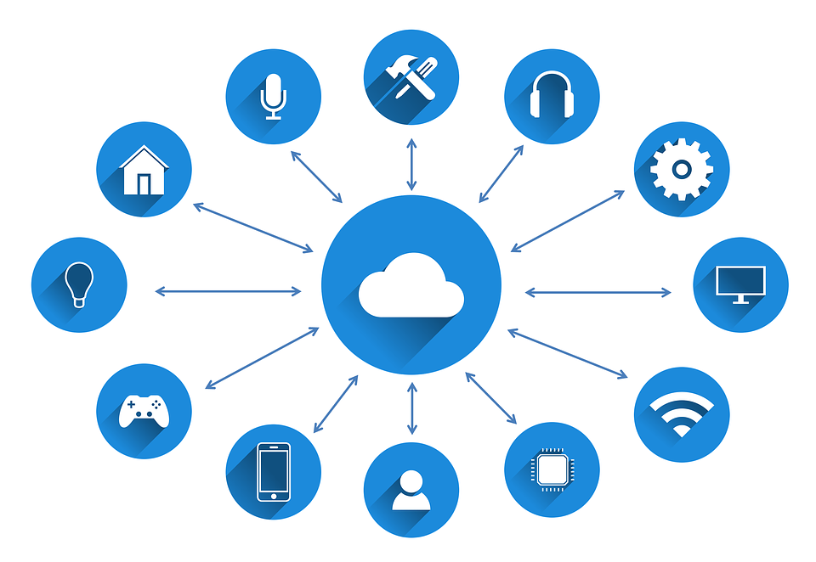
Cloud Models – Cloud Computing
Applications
Applications
Cloud Provider’s Network
Virtual Machines
California DC
IoT Devices
Host Machine
Host Machine
Florida Fleet
Notes:
Cloud computing – all processing is sent to the Cloud Provider network, processed, returned and stored

Slide 3


Cloud Models – Edge Computing
Applications
Applications
Cloud Computing
Edge Computing
Virtual Machines
IoT Devices
Host Machine
Host Machine
Notes:
Edge computing allows the devices to process their own data within the LAN

Slide 4
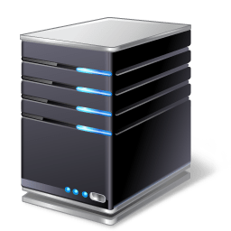
Cloud Models – Fog Computing
Cloud Provider
Fog Nodes
IoT Gateway
Virtual Machines
IoT Devices
Notes:
Fog computing allows the data to be sent through a gateway device to Fog nodes to be processed and returned

Slide 5

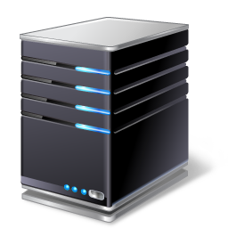
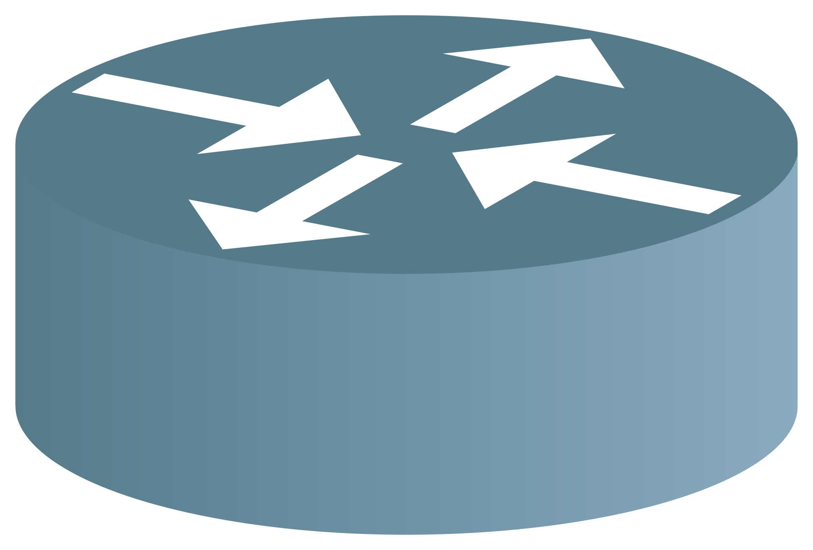

Managed Service Provider (MSP)
Outsourced managing of IT infrastructure
Examples
Network
Applications
Infrastructure
Security

Slide 6




Managed Security Service Provider (MSSP)
Outsourced monitoring and management of security systems
Examples
Monitoring, Detection, Alerting
Firewall Management
VPN Services

Slide 7
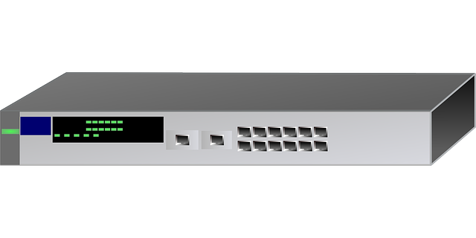
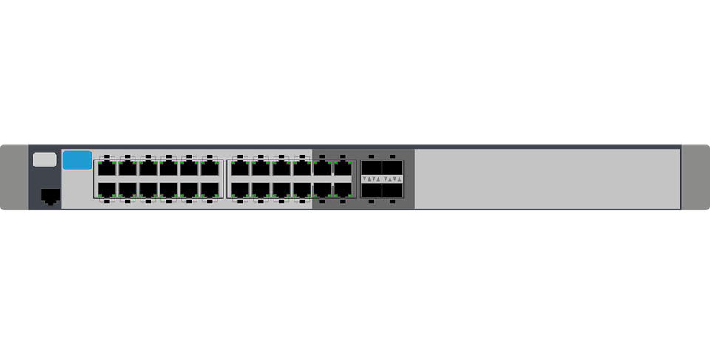
Software-defined Networking (SDN)
Application Layer
Business Applications
Northbound API
REST API
Control Layer
SDN Controller
Southbound API
OpenFlow
Infrastructure Layer
Network Devices
Notes:
Allowing a business to programmatically control the network traffic flows through software
SDN Controller is the orchestrator
Reconfigure the direction of traffic flow without a necessity to physically reconfigure the network devices
The infrastructure layer can be made up of dissimilar and even proprietary interfaces and since that is abstracted, it is not a concern.

